Slide 1




Webinar On
Generative AI: What's in it for content creators and content consumers?
Speaker
Selvaraaju Murugesan
Head of Data Science, Kovai.co

Slide 2



Overview
Intro to Generative AI (GenAI)
GenAI in content creation
GenAI in content consumers
Notes:
Example

Slide 3




Session 1
Notes:
Session 1

Slide 4
Generative AI
Autocompletion in steroids and it can complete up to 8000 word in one go!

Slide 5
How does Large Language Model (LLM) get built?
“The best thing about technology is its ability to”……..
Next word | Probability (% form)
Connect | 26.24%
Make | 16.58%
Help | 6.33%
Bring | 5.83%
* Temperature parameter : 0 - 1

Slide 6
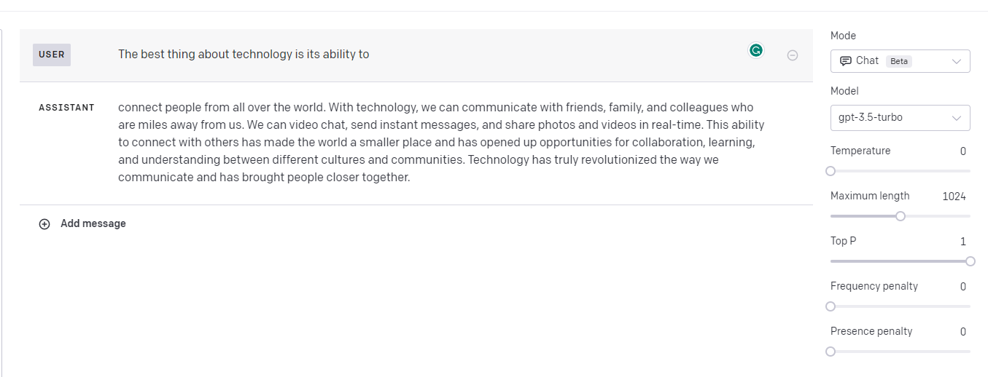
Completion API response
Temperate = 0.0

Slide 7
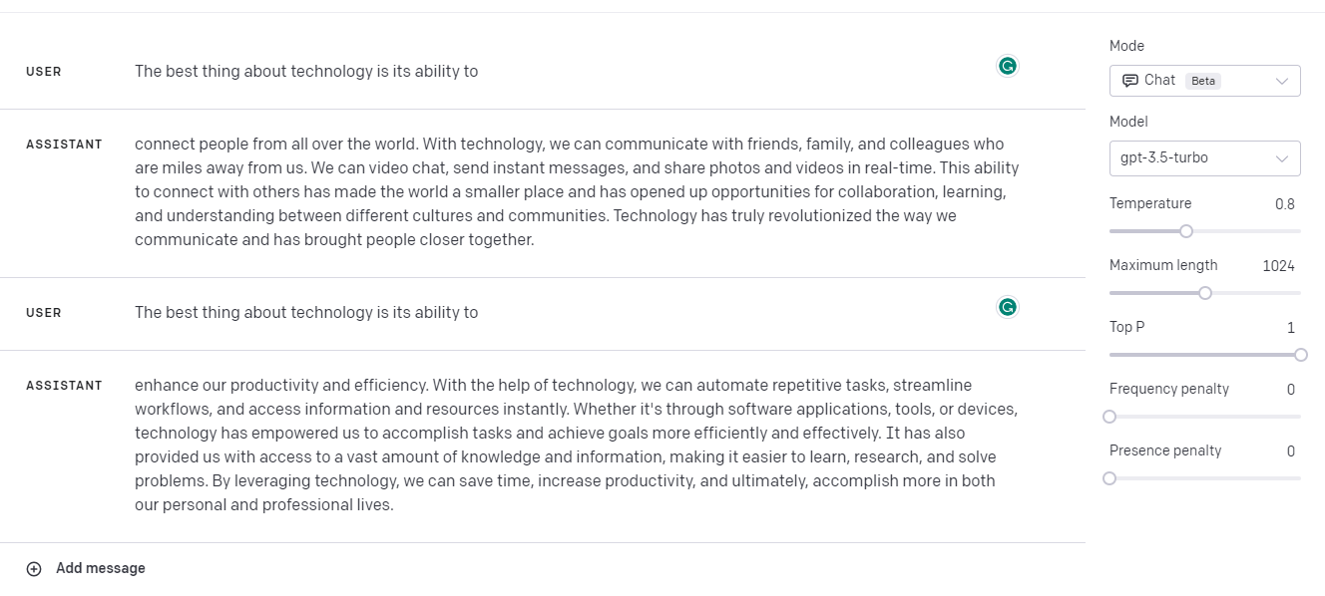
Completion API response
Temperate = 0.8

Slide 8
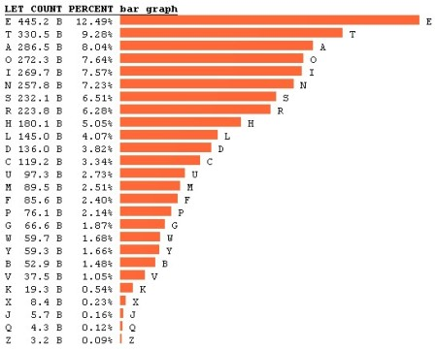
Where does this probability come from?

Slide 9
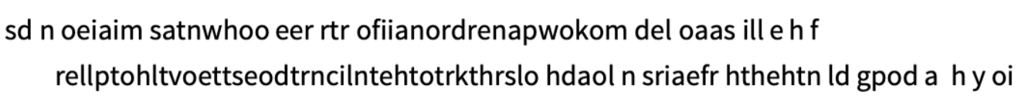
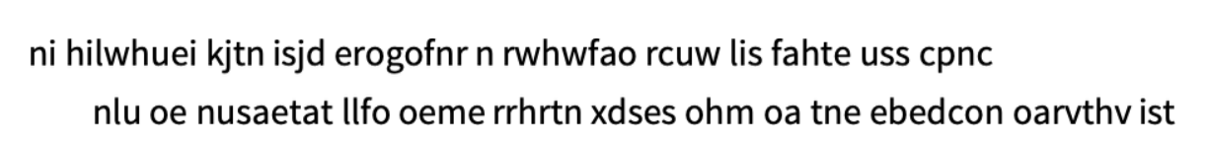
Generate sequence of letters
Break this into words with some probability
Distribution of word lengths

Slide 10
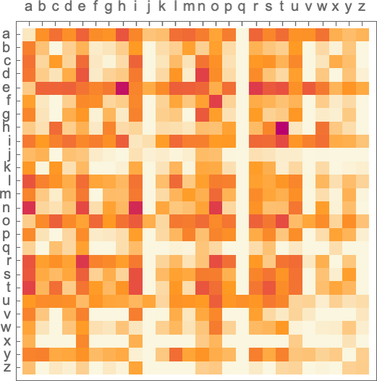
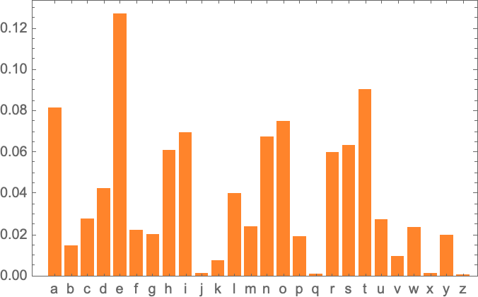
Probabilities
Same letter
Pair of letters

Slide 11
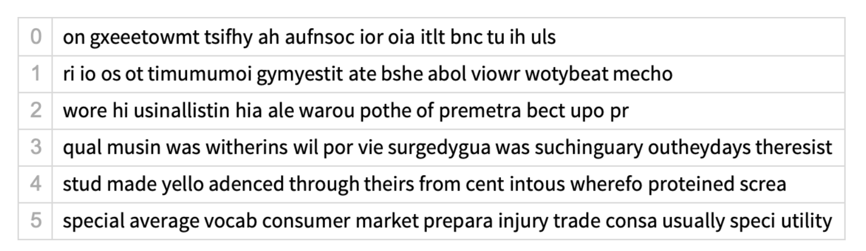
Sentence generation

Slide 12
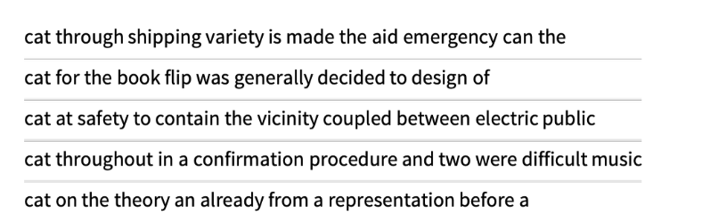
N-grams and common words

Slide 13
Large Language Model (LLM)
N-grams | Probabilities of words
2-grams | 1.6 billion
3-gram | 60 trillion
GPT-3 | 175 billion
GPT-4 | 100 trillion
Llama 2 (Meta) | 70 billion
PaLM 2 (Google) | 340 billion
LLM | Estimating probabilities

Slide 14
Large Language Model (LLM)
Given large corpus of text data, LLMs can self-teach themselves on the grammar and sentence structure
Understands context and relations
Traverse a path to auto-complete a sentence
When the fact change, LLMs cannot cope with – Use of plugins & ChatGPT+

Slide 15




LLM APIs

Slide 16



Content creation
Productivity
Quicker
Companion

Slide 17

Content creation - Use cases
Outline creation
Paraphrase content
Change tone, voice, speech
Notes:
Example

Slide 18
Content creation - Use cases
Grammar and punctuation
Semantic check
Content longer / shorter
Notes:
Example

Slide 19

Prompt Engineering

Slide 20

Notes:
On page SEO
Technical SEO
Off page SEO
Google search for document360 workflow

Slide 21
Session 2
Notes:
Session 1

Slide 22
Major shift in how customers are accessing documentation is happening now !
Notes:
Outline
Introduction to AI and Large Language Models (LLMs)
Brief about Generative AI technologies such as ChatGPT and Bard
Content creation for LLMs
Content length and quality
Business glossary
Exercise - 1
Tables
Media content
Exercise - 2
Content evaluation metrics
Content quality
AI content Ingestability scoring
Best practices
Exercise - 3
Close

Slide 23





Trends
Able to do things quickly
Any time, any where, any device
Accurate answers

Slide 24

Trends
Preferences
Different style and forms to consume content

Slide 25
Trends | Then | Now
Audience of your knowledge base | Humans | Artificial Intelligence bot
Content discovery engine | Search engines such as Google, Bing, and so on | Generative AI such as ChatGPT, Bard, and so on
Content discovery optimization | Search Engine Optimization (SEO) | Semantics content structuring
Content discovery mechanisms | Search keywords | Prompt
Outcomes of knowledge consumption | Humans doing work | Artificial Intelligence bot doing work with minimal human intervention

Slide 26

Retrieval Augmented Generation (RAG)
Sets the behaviour of how the LLM should take instructions and respond
Example : customer support agent
If the response cannot be generated within the context, then the AI Assistant should say
“I do not know”

Slide 27



Concepts
Tokens
1 token ≈ 4 character
Words
100 tokens ≈ 75 words
Paragraph
1 paragraph ≈ 100 tokens

Slide 28
Architecture of RAG
Knowledge base
Store Embeddings in a vector DB with article references
Extract all HTML / XML content from DB
Pre-process the content
Split long articles into smaller chunks
(500 tokens)
Create Embeddings
Embedding is a process of converting text into floating point numbers
OpenAI Model : text-embedding-ada-002

Slide 29
Architecture of RAG
Questions
Answer
Convert questions into Embeddings
Calculate distance between Embeddings from DB
Pick up top 5 context
Use text completion APIs to generate a response
Distance between Embeddings measure their relatedness
OpenAI Model for text completion: text-davinci-003

Slide 30
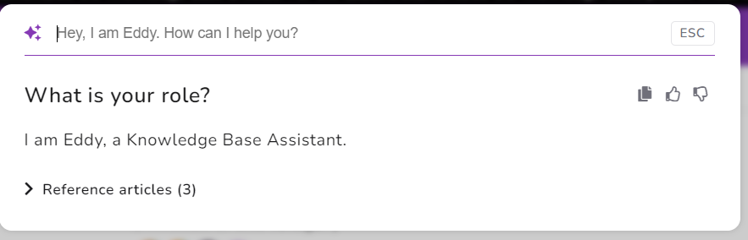
System message - Example
As a customer support representative, provide answers to questions based on following rules
Answer questions using only the provided context and format the answer in Markdown.
Answer the question in professional tone
If the answer is not generated within the context, please respond with “I do not know” message

Slide 31

System message
Determines behaviour
Not revealed to end users
Use it to fight against “prompt injection attacks”
Must be tweaked over time after analysis of logged questions

Slide 32

Context
Relevant retrieved chunks that contains the context to answer the question
More context, better it is to provide an accurate response; However, it takes more time to execute!
Shorter chunks gives macro context; Longer chunks gives micro context

Slide 33

Prompts
User questions
Know the intent of the “ASK”
Outputs is customizable and in control of the user
Accurate answers

Slide 34

AI Assistant Analytics
Technical writers can understand user intent better
Search keyword offer no clue of the user intent!!
Address existing knowledge gaps
Drive business outcomes such as customer satisfaction, self-service rate and so on

Slide 35
AI Assistant Analytics
What type of questions are being asked?
  Why those questions are being asked?
  Classification of questions
What content is very critical?
  What content is old?
  What content needs high accuracy?
Which information needs to be up to date?

Slide 36
Notes:
On page SEO
Technical SEO
Off page SEO
Google search for document360 workflow

Slide 37
Questions ?

Slide 38


Thank You!

